Slide 1


Election Voting System
Course Project: Programming in C
Class : FY-MCA
Year : 2021-2022
Guided By:
Mrs.Deepali Salapurkar.
By:-
Aditya Jadhav.
FY-MCA Roll No. 28
Mohammed Mujtaba Iqba
FY-MCA Roll No. 42
Suraj Prakash Patil.
FY-MCA Roll No. 45
Prajwal Pal
FY-MCA Roll No.47

Slide 2
Contents of Course Project
Problem Statement
Scope of the Project
Objective
Algorithm
Result
Conclusion
References

Slide 3
Problem Statement
Always there is a need of Election in Democracy System.
Election is Done by Voting Using voting machines.
This machines can be manipluates votes or miss some votes to count Or not detect Blank votes by voter.
It Results some Scams or Selection of Good Leader not Done.
so ,We Try to Develop a Election Voting System.

Slide 4
Scope of the Project
Simple voting Environment to voters
4 different Options to voter
Result
Difference between voters
Vote Finish
Exit Poll
Voter List Must Be there for Vote
Voter Age is 18+ --- (Assumption)
Votes Will Count And Show the Votes Difference between Candidates.

Slide 5
Objective
This Project main is to provide safe and secure voting system environment.
Simple to Use and May Future need this.
Voting does not to be scam. This project is safe and secure.
Admin can allow the user to vote, and admin can declare a result.

Slide 6
Flow Chart
START
Register Candidates
Read Voter ID of Voter
NO
YES
You are Not An Eligible Voter.
Is Voter
Registeredd
?
Enter Symbol of Candidate to Vote
Is Vote Successful
?
Update Vote Count
END
Confirm Vote Message

Slide 7
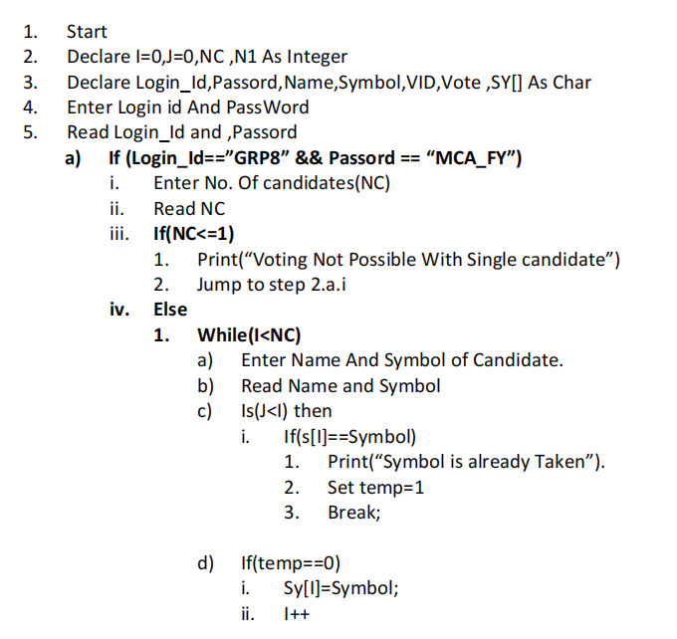
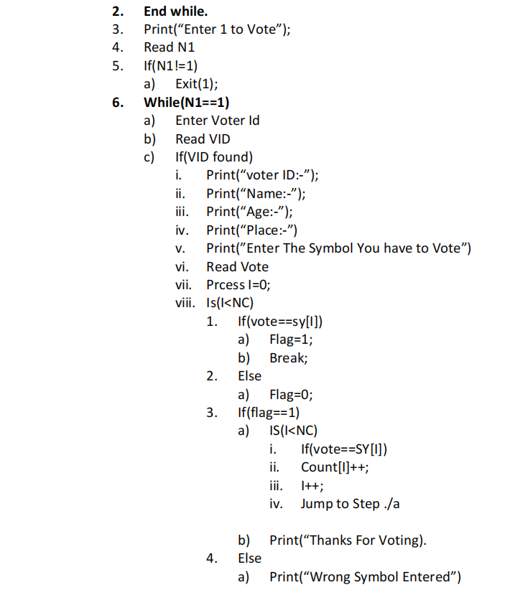
Algorithm

Slide 8
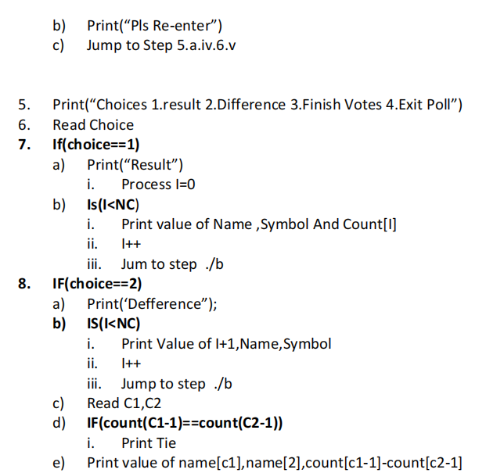
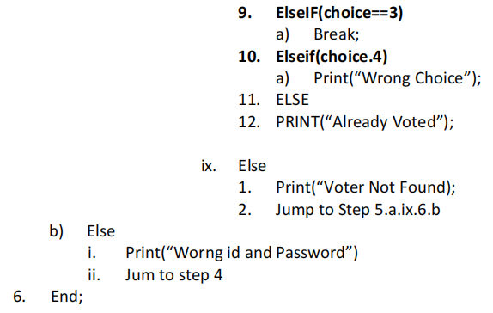

Slide 9
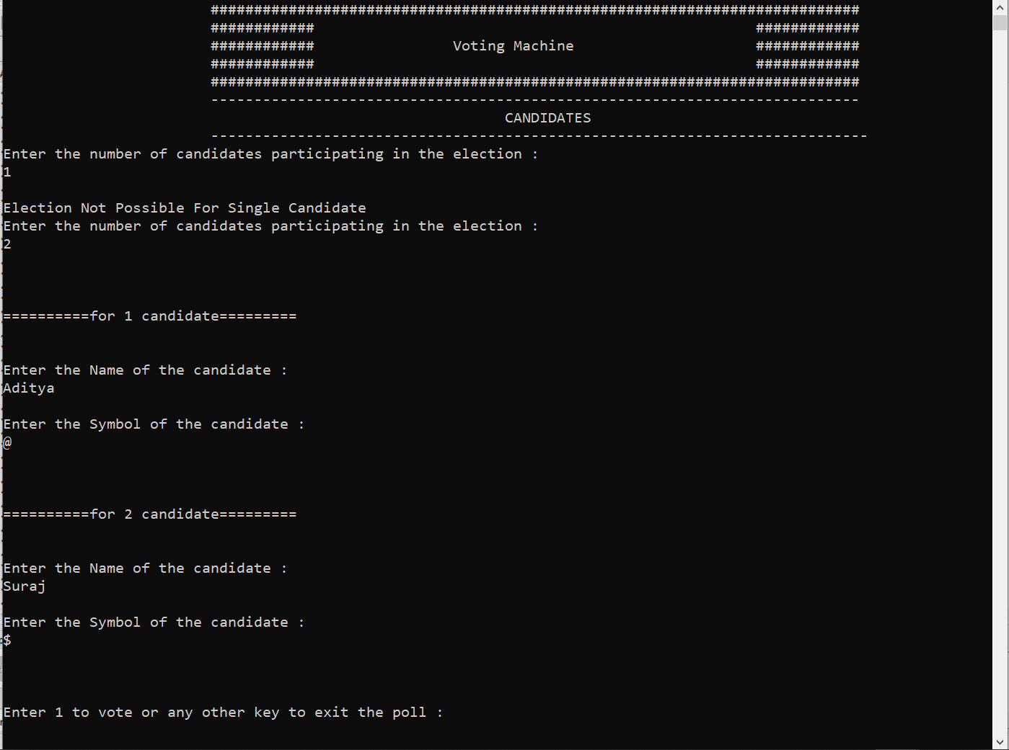
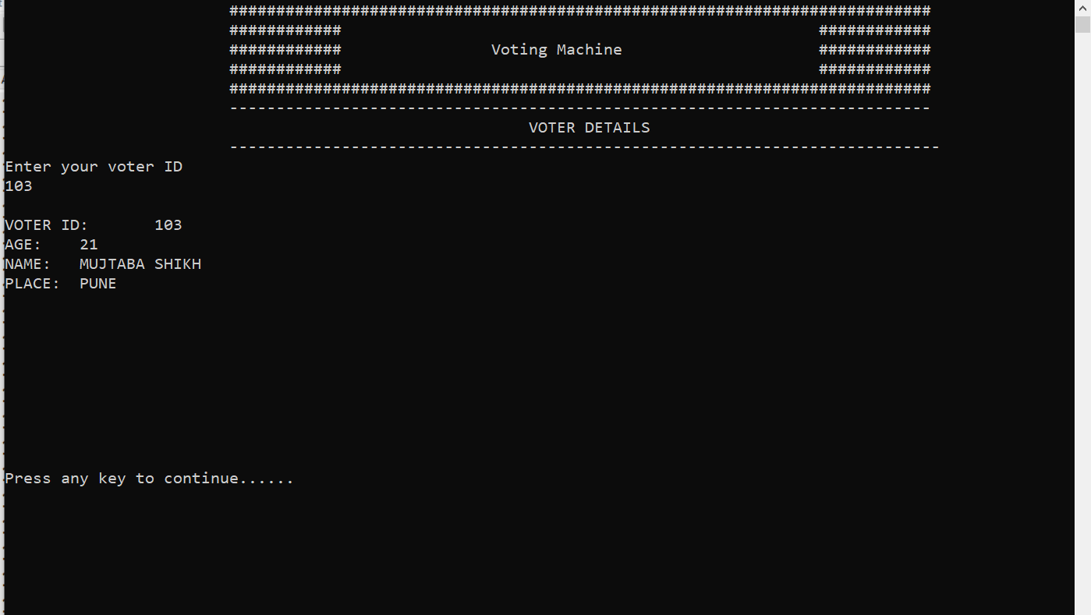
Result/ScreenShot

Slide 10
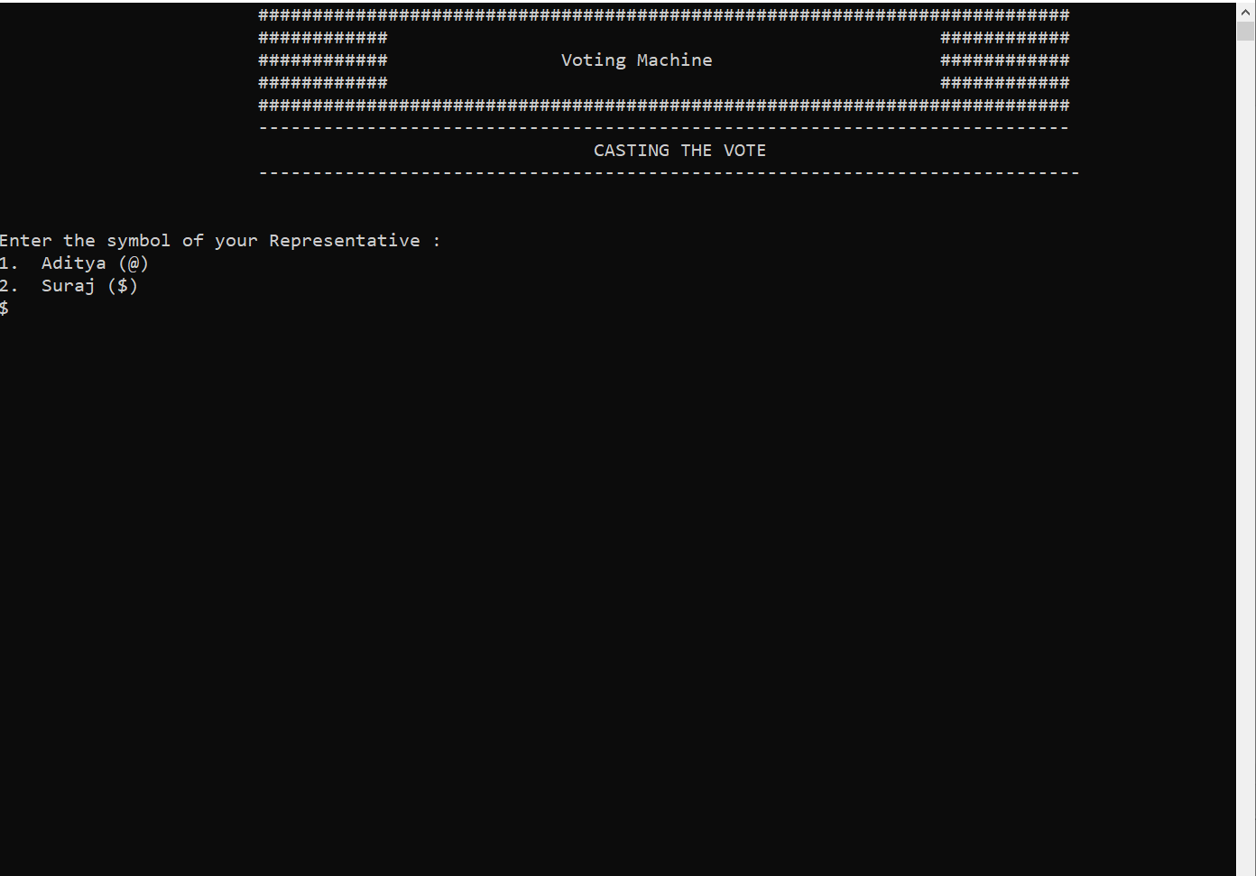
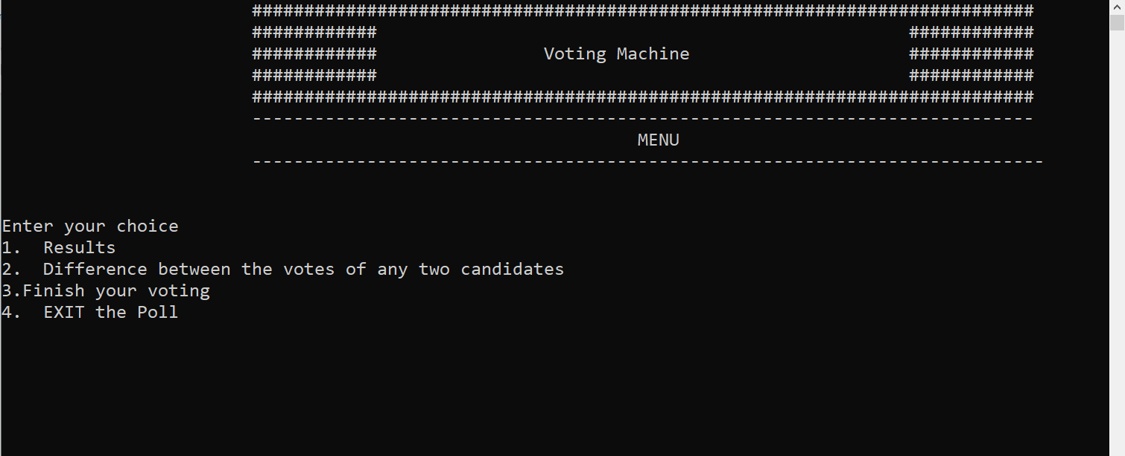
Vote Casting Window
Menu Window

Slide 11
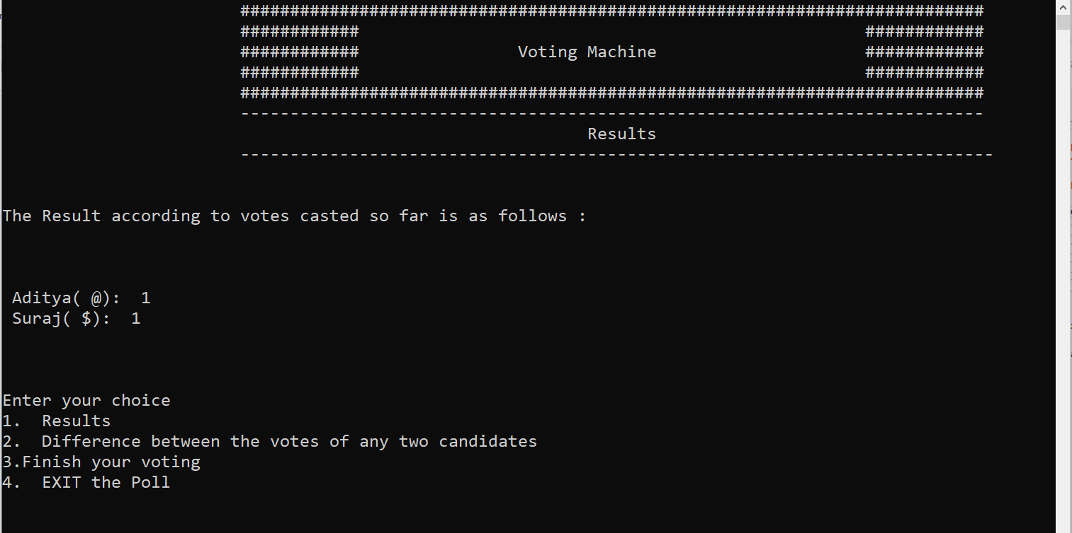
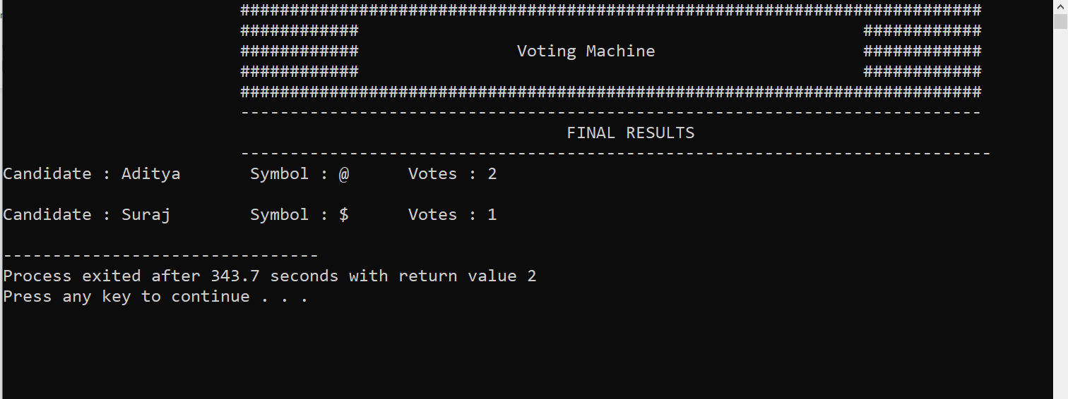
Final Result Window
Result Window

Slide 12

Conclusion
Voting System we can give a user a safe and good Voting environment
Direct count of vote Display Easily.
It Save Time to Count Votes of Candidates
Select a good Leader Candidate As Voters Give Votes.

Slide 13
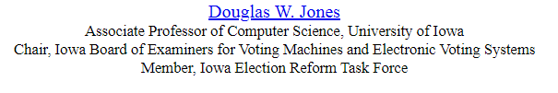
References
Problems with Voting Systems and the Applicable Standards
https://homepage.divms.uiowa.edu/~jones/voting/congress.html
C plusplus Reference- https://www.cplusplus.com/reference/
IMages Pick From Istock.com,FreePick.com

Slide 14


